Slide 1

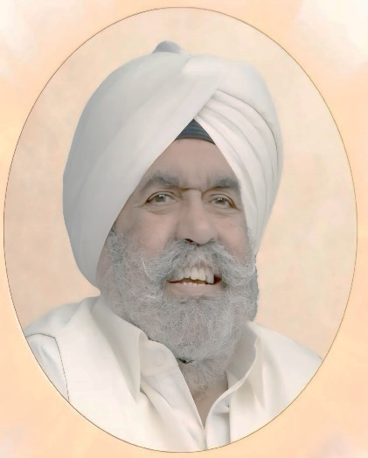
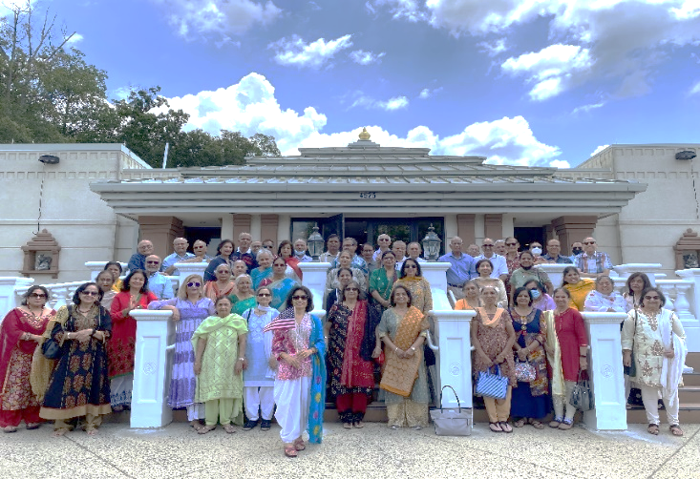


ANTAKSHRI, JOKES & BINGO Game
4525 Pleasant Valley Road, Chantilly, VA 20151, Tel: 703-378-8401 Website: www.RajdhaniMandir.Org FB Rajdhani.Mandir
SADABAHAAR SENIOR GROUP MEETING SEPTEMBER 7^{th,} 2025
Talk on Inner Peace thru Meditation
Sant Rajinder Singh Ji Maharaj Birthday Celebration
Sunday September 7, 2025
4:00pm – 6:00pm
Talk on Inner Peace thru Meditation
And also
Sant Rajinder Singh Ji Maharaj
Birthday Celebration
Dinner will be Served, Senior’s Dinner Sponsored by
Science of Spirituality
Anu Rai Gupta in honor of her late Father
Shashi Swami
Please RSVP by September 4th Sadabahaarclub@gmail.com
Please bring any Seniors you know for excellent networking, knowledge sharing, socializing and entertainment during Seniors’ Meeting
For details, please contact
Shashi Chopra: CHOPRA.SHASHI@GMAIL.COM Tel. 703-731-7370
Ravi Chopra: CHOPRA.RAVI@GMAIL.COM Tel. 703-731-5727

